Slide 1
ELECTRICAL SCIENCE-1
(15B11EC111)
Unit-5
AC Network Analysis and Theorems
(Mesh and Nodal analysis, Superposition Theorem, Thevenin’s Theorem, Norton’s Theorem, Maximum Power Transfer Theorem)
Lecture-6
Dr. Abhishek Kashyap
Assistant Professor (Senior Grade, JIIT Noida)

Slide 2
Topics to be covered
MAXIMUM POWER TRANSFER THEOREM
PROBLEMS
PRACTICE PROBLEMS
REFERENCES
2

Slide 3
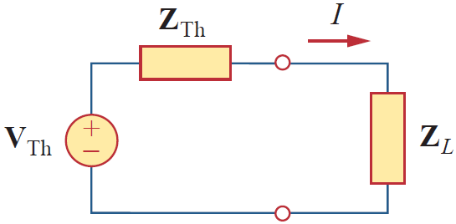
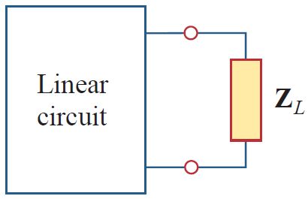
Maximum Average Power Transfer
In the case of circuit having resistive load, maximum power would be delivered to the load if the load resistance is equal to the Thevenin resistance R_{L} = R_{Th}.
In case of AC Circuit:
(a) AC circuit with a load,
(b) The Thevenin equivalent.

Slide 4
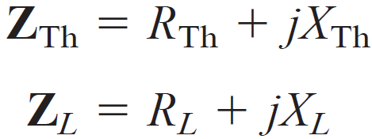
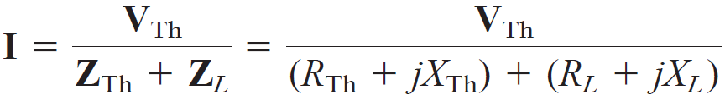
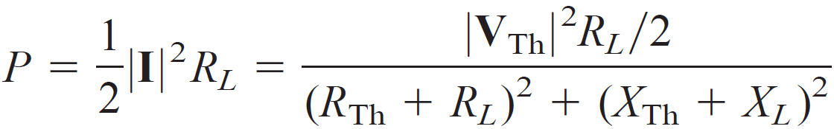
Maximum Average Power Transfer
In rectangular form, the Thevenin impedance Z_{Th} and the load impedance Z_{L} are
Current through the load,
Average power delivered to the load,

Slide 5
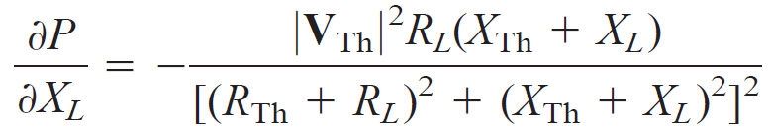
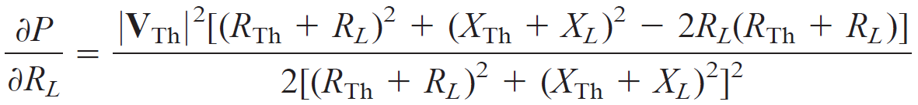
Maximum Average Power Transfer
---------- (1)
Our objective is to adjust the load parameters R_{L} and X_{L} so that P is maximum.
To do this we set

Slide 6
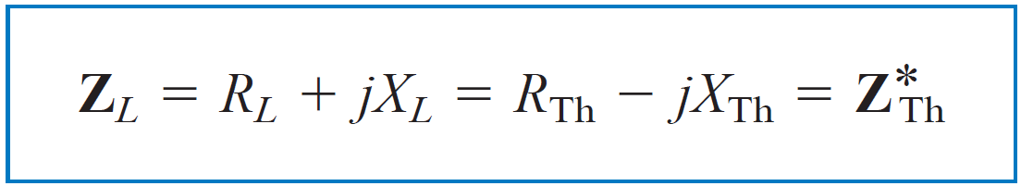

Maximum Average Power Transfer
---------- (2)
---------- (3)
Combining Eqs. (2) and (3) leads to the conclusion that for maximum average power transfer, Z_{L} must be selected so that X_{L} = -X_{Th} and
R_{L} = R_{Th} i.e.,
This result is known as the maximum average power transfer theorem for the sinusoidal steady state.

Slide 7
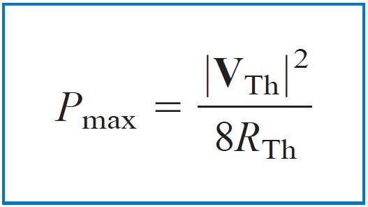

Maximum Average Power Transfer
---------- (1)
Setting R_{L} = R_{Th} and X_{L} = -X_{Th} in Eq. (1) gives us the maximum average power as
When load is purely real, consider the Eq. (3), and set X_{L} = 0
that is,
This means that for maximum average power transfer to a purely resistive load, the load impedance (or resistance) is equal to the magnitude of the Thevenin impedance.

Slide 8
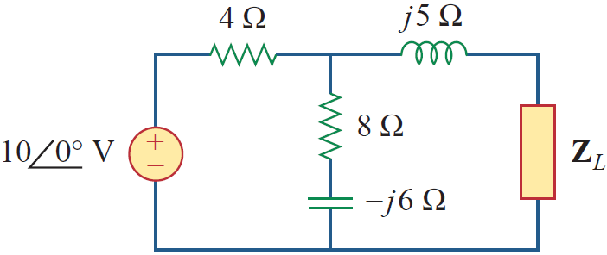
Example
Determine the load impedance Z_{L} that maximizes the average power drawn from the circuit of Fig. What is the maximum average power?
Solution:
First we obtain the Thevenin equivalent at the load terminals.

Slide 9
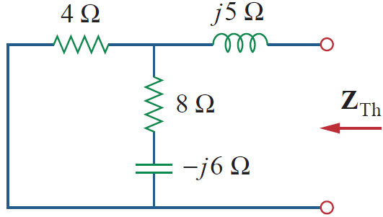

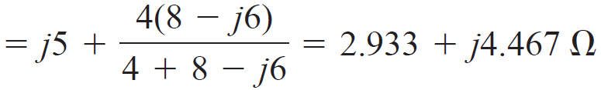
Solution
Find Z_{Th}:

Slide 10
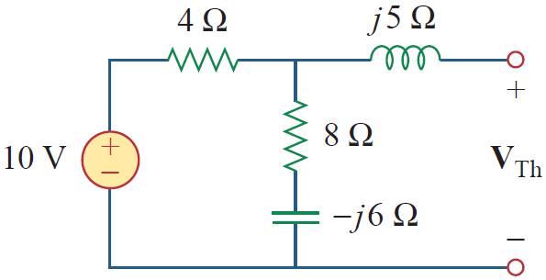
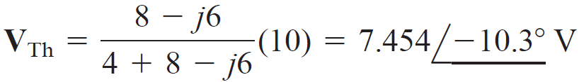
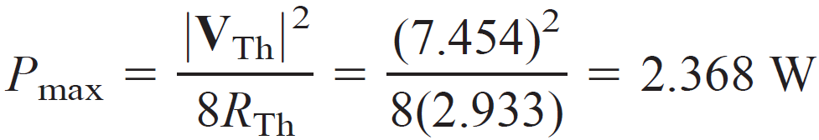
Solution
Find V_{Th}:
By voltage division,
The load impedance draws the maximum power from the circuit when
the maximum average power is

Slide 11
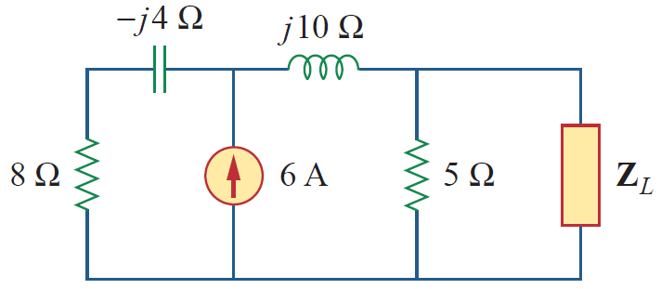

Practice Problem
For the circuit shown in Fig., find the load impedance Z_{L} that absorbs the maximum average power. Calculate that maximum average power.
Answer:

Slide 12
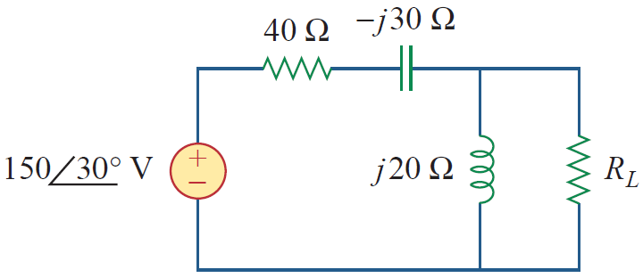
Example
In the circuit in Fig., find the value of R_{L} that will absorb the maximum average power. Calculate that power.
Solution:
We first find the Thevenin equivalent at the terminals of R_{L}.

Slide 13

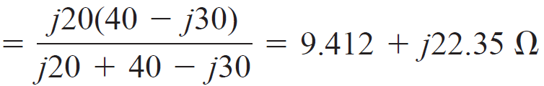
Solution

Slide 14
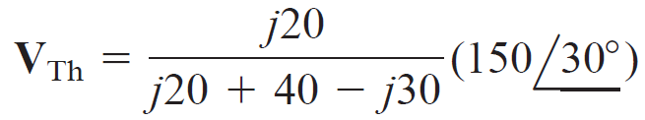

Solution
By voltage division,
The value of R_{L} that will absorb the maximum average power is

Slide 15
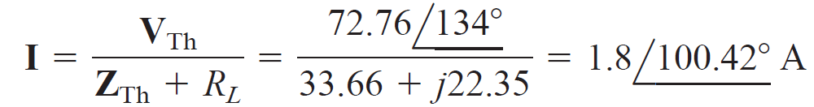
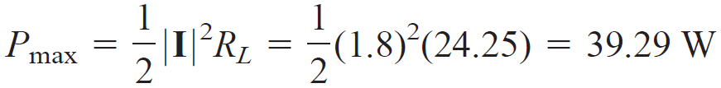
Solution
The current through the load is
The maximum average power absorbed by R_{L} is

Slide 16
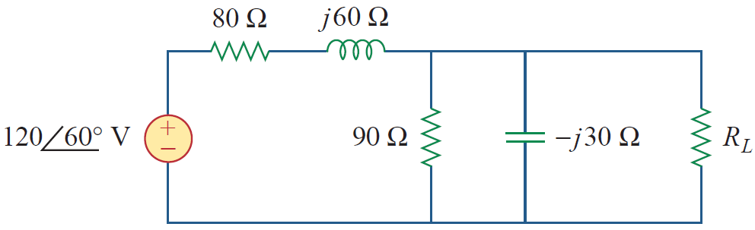

Practice Problem
In Fig., the resistor R_{L} is adjusted until it absorbs the maximum average power. Calculate R_{L} and the maximum average power absorbed by it..
Answer:

Slide 17
References
Charles K. Alexander (Author), Matthew N.O Sadiku, “ Fundamentals of Electric Circuits”, 6th ed, Tata Mc Graw Hill, 2019..
D.C. Kulshreshtha, Basic Electrical Engineering, Revised 1st ed, Tata Mc Graw Hill, 2017.
V. K.Mehta, Rohit Mehta, Basic Electrical Engineering, 6th ed, S. Chand Publishing, 2012.

Slide 18
Thanks

